Slide 1


Slide 2
Vision
To envision a future where querying databases is as simple as asking a question, our goal is to build a more fact-driven world by making insights available to every knowledge worker

Slide 3
Product Concept
Revolutionizes the way users interact with databases by offering a seamless natural language querying experience
Offering an interactive natural language interface that generates executable queries in various programming languages, leveraging schema awareness
What
How
DataNinja is a GPT that understands the structure of the database, allowing it to interpret queries accurately and generate efficient code.
Regardless of technical expertise or database type, DataNinja strives to improve productivity and decision-making processes across organizations.
Means
Value

Slide 4

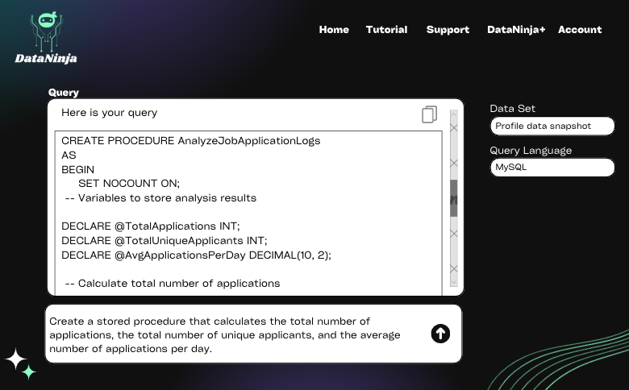
End-user Interface

Slide 5
Market Opportunities
Data Democratization
Skill Barrier
Increased Productivity
Database querying is essential across every industries.
Example: CPG, Social Platforms, Real estate, etc
Data captured is available in huge volumes and information traceability is challenging
Decisions are data driven & information loss is highly likely when passed through hierarchy
Product Managers & Leadership can extract insights easily
Less time writing and troubleshooting complex queries
More time in analysing the results and making data-driven decisions.

Slide 6


Product Strategy
Technology Advancements
Vision
Design
Querying databases is as simple as asking a question
Ready Stories
Intuitive and user-friendly interface
Focus on simplicity & accessibility
Gamification of user journey
Staying at the forefront of innovation:
Advancements in AI
Deliver maximum value
New feature roll-outs
Unlocking adjacent markets
Create a list of ready user stories that cover at least the first sprint.
Constraints
Growth & Marketing
Data Driven
Technology Compatibility
Resource Limitations
Data Privacy & Security
User preferences & Adoption barriers
Budget
Tailored user acquisition strategies for user segments
Implement referral programs
Seamless user onboarding experience
Providing regular product updates, personalized recommendations
Utilize analytics and user insights to inform product decisions
Prioritize feature development
User behavior analysis
Identify areas for improvement
Personas
User feedback
Personas as a priority:
Product Managers
Leadership
BI Executives
Sales Executives
Other Data Users
Understand how they use the product & its features.
Continuous feedback loop
Customize design needs for large enterprise customers
Limitations
Extremely complex databases
AI recommended database creation
Data Management
Notes:
Technology – stay at top of AI innovations – by leveraging this we want to deliver maximum value of our product – also unlock adjacent markets – targeting every industry possible where they would not just use for querying but also visualizations and insights which is in the future phase of our product
Buyer personas include product managers, executives who might not possess great SQL skills, and even technically skilled BI specialists and analysts to make their lives easier and reduce workload.
Technology constraint – like when shipping our product, there might be gaps in the technical documentation which would require back-and-forth communication
Compatibility and performance-related constraints wherein the users may not have technical relevant knowledge on the capability of the product.
Data and privacy constraints – most organizations are sensitive about their data and would not want their information stored in our databases
Market constraints – If the capability of the product becomes sort of an inbuilt feature of existing products, it might become a “Me Too” problem, continuous market research is required to understand evolving user preferences in this domain
Financial constraints like acquiring initial investors and ensuring product affordability for a diverse set of industry users
Design strategy
Have user feedback in the core of our strategy plans – ensure how user use our product and features based on which design level or preference level personalization could be incorporated
Lastly, the limitations of our product: understanding heavy and complex database design and AI recommendations for building databases.

Slide 7
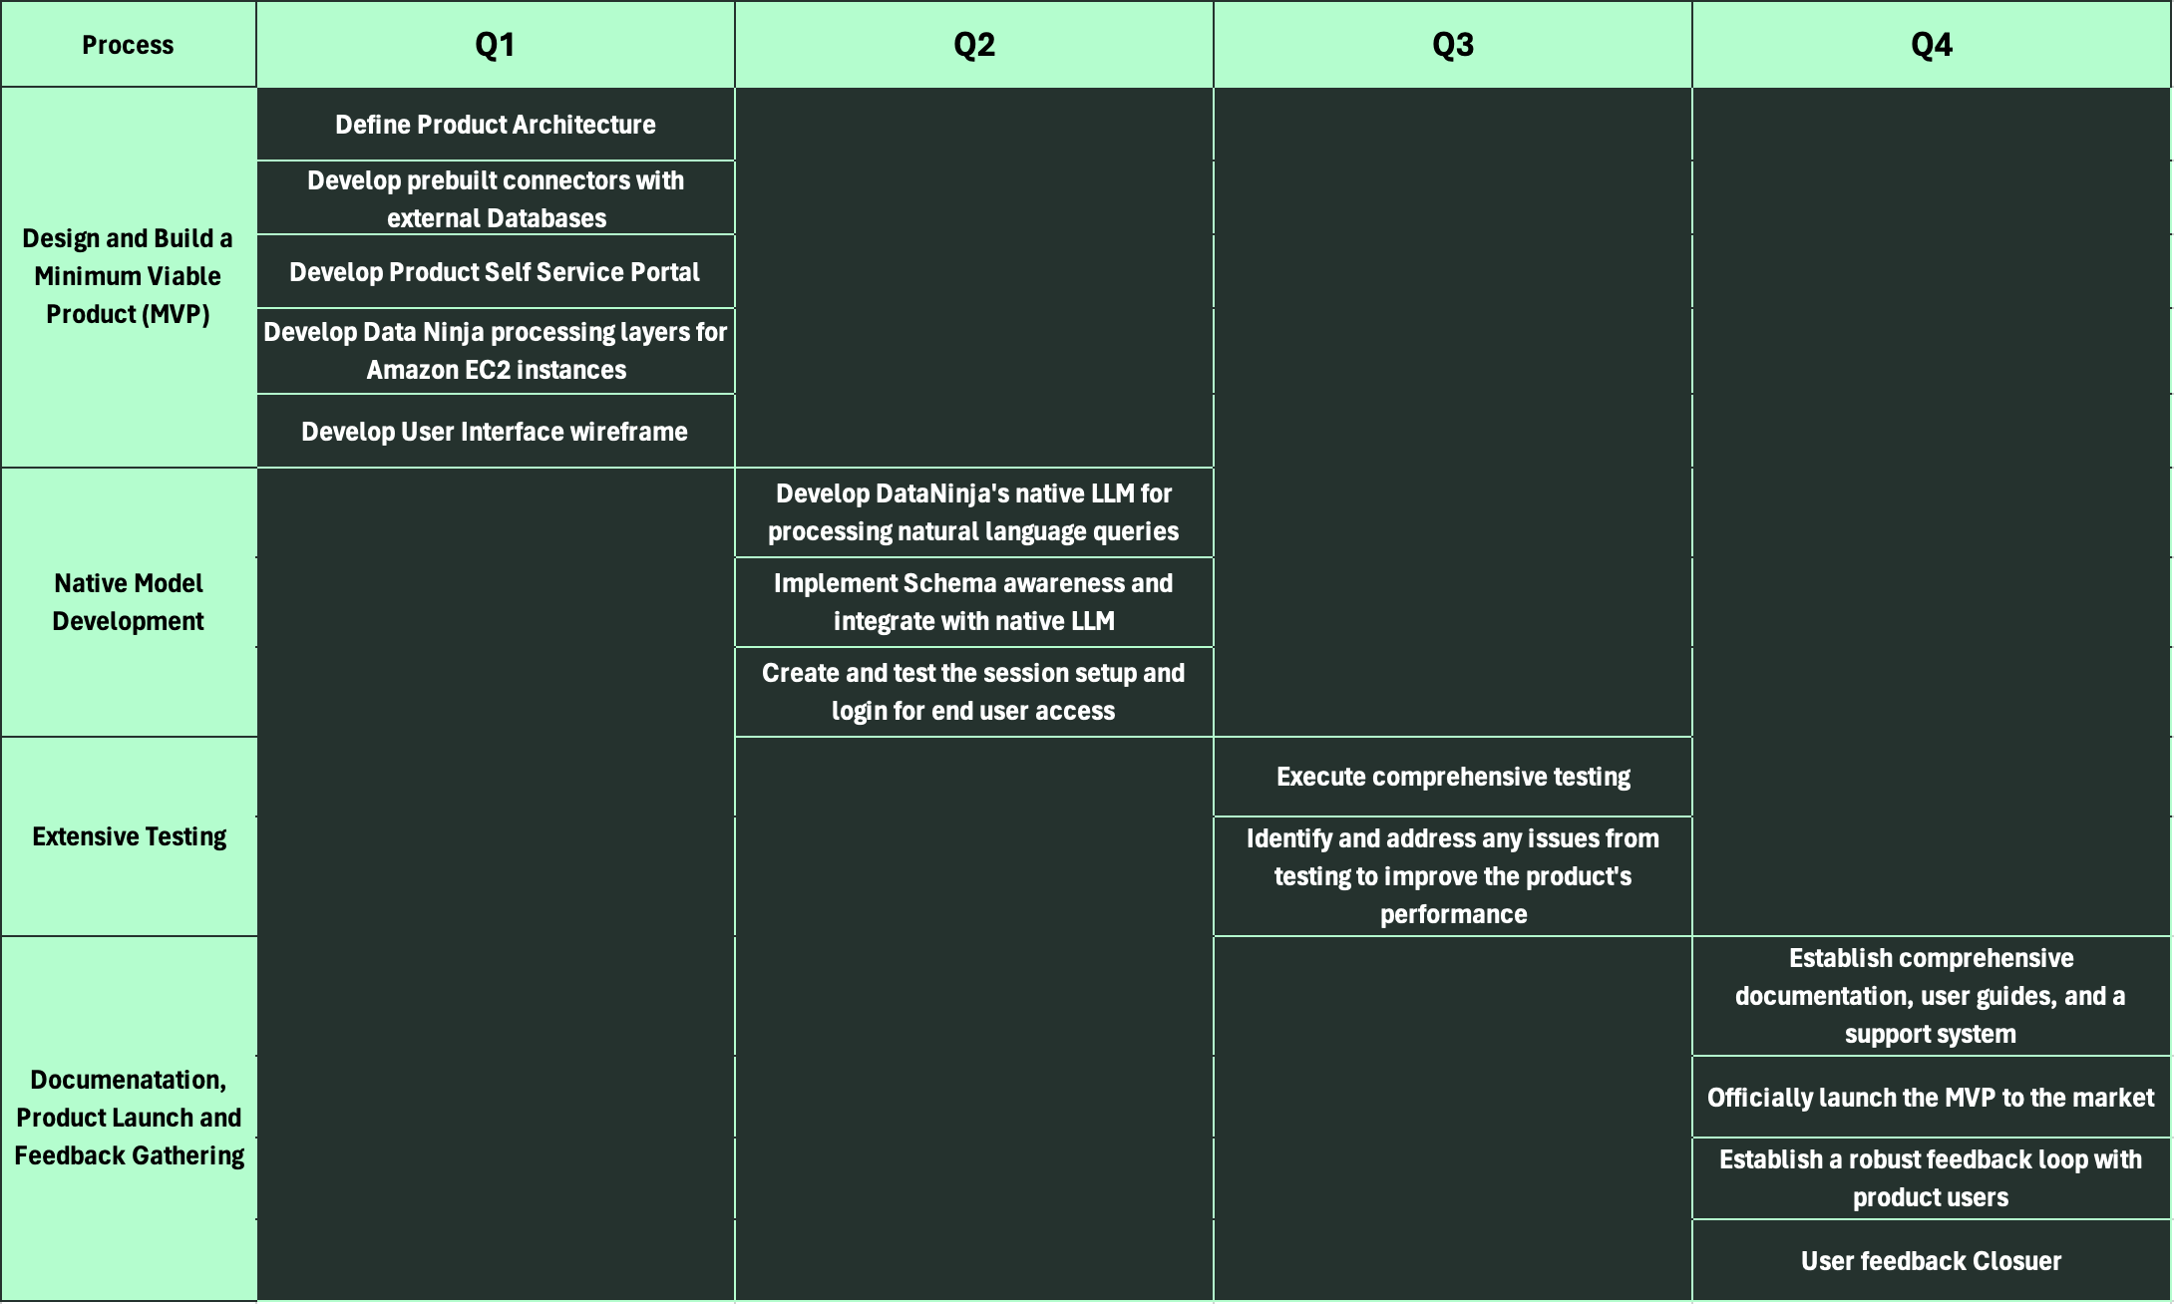

Phase 1 Roadmap (2024)

Slide 8
Phase 2 & Beyond (2025 – 2026)
Future releases
H1
2025
H2
2025
H1
2026
H2
2026
Capability extension & model training to support multiple languages, visualizations & Chatbot Support.
Implement mechanisms to connect DataNinja to databases securely and retrieve data
User interface enhancements to facilitate data exploration and visualization.
User Acceptance Testing of Launch of DataNinja version 2.0
Capability extension to support NoSQL databases.
Automated AI Insights & Recommendations
User feedback improvements
Market Expansion & User Stickiness
Version 2.0

Slide 9
Enterprise Licensing
Usage-Based Pricing
Involve a significant upfront payment in exchange for access to the platform for a specified period & users
Charged based on the actual usage of the platform. E.g. Number of queries or the amount of data processed.
Revenue Model
Subscription Fees
Add-on Features
Recurring subscription fee for accessing the platform, priced at a variety of options. Eg., No. of users/features levels
Features as needed to tailor the platform to specific requirements.
Partnerships and Alliances
Professional Services
Integrations/Technology consulting/ Deploying Data infra to help customers optimize their use of Data platforms
Revenue through partnerships and alliances with other technology companies.
Notes:
This is the Revenue Model we are envisioning for DataNinja.
Our largest segment would be selling the product offerings in the form of licenses which will involve a significant upfront payment.
The next one is Subscription fees – where we will accommodate a couple of purchase options based on the feature bundles.
Usage based pricing like AWS., Eg., based on the number of queries executed or the amount of data processed they will be billed.
Offering custom features & evaluating the value provided for our customers we are planning to create a revenue stream.
After creating a high-level user stickiness, another potential revenue stream is where we will introduce professional services, this means any integrations/technology consulting/deploying data infrastructure when customers want to use DataNinja as their primary D&A tool and they reach out to us with a major change management in their roadmap, we will be doing professional services.
This is where we will be able to fit in partnership & alliances as well

Slide 10
Competitor Landscape
Features | ThoughtSpot | Kinetica | DataNinja
Natural Language Interface | Yes | Yes | Yes
Complexity | Need to follow exact naming conventions as used in data source | Requires technical expertise in analytics and computing | Minimal technical requirement to understand the query generated
Query Generated | Does not generate queries | SQL queries | Relational Database & NoSQL queries & stored procedures
Real-Time Analytics offering | None | Geospatial & real-time analytics | High-speed real-time analytics
Insights & Recommendations | Insights only reads out graph | No insights/recommendations | Offers Generative recommendations based on visualizations
Scalability | Limited for on-prem deployments | Scalable with GPU | Scalable with computational resources
Industry Use Cases | For Business users to explore data | Telecom & Financial organizations for analytics | Small to Global organizations for query productivity & extensive analytics

Slide 11
Pricing Tiers – Phase 1
GENIN (Basic)
$109/month
CHUNIN (Essentials)
$1440/month
JONIN (Pro)
Custom
KAGE (Enterprise)
Custom
5 Users
1 Database
1 Permission Group
Basic Support
20 Users
Multiple Databases
5 Permission Groups
Basic Support
CUSTOM Users (min - 25)
Multiple Databases
Custom Permission Groups
Pro Level Support
CUSTOM Users (min – 100)
Multiple Databases
Unlimited Permission Groups
Enterprise Support
Note: Pricing based on competitor feature & pricing analysis.
DataNinja pricing is 15% more than Thoughtspot and 9% more than Kinetica.

Slide 12
Pricing Tiers – Phase 2*
GENIN (Basic) $130/month
CHUNIN (Essentials) $1730/month
JONIN (Pro)
Custom
KAGE (Enterprise) Custom
5 Users
1 Database
1 Permission Group
Basic Support
Standard Security*
100 GB/month*
20 Users
Multiple Databases
5 Permission Groups
Basic Support
Standard Security*
500 GB/month*
Custom Users
Multiple Databases
Custom Permission Groups
Pro Level Support
Pro Level Security*
10 TB/month*
Custom Users
Multiple Databases
Unlimited Permission Groups
Enterprise Support
Enterprise Security*
Custom*
Note: Phase 2 pricing increased by 20% from phase 1, anticipating competition in market.
Notes:
Standard security controls include data encryption in transit, disk-level data encryption at rest.
Pro Level security controls adds single sign-on and row-level security.
Enterprise security controls adds advanced, granular data encryption at rest down to the database, folder or file level, as well as private communication link between DataNinja and the data sources

Slide 13
Sales & Marketing Channels
Online Marketing
LinkedIn & Google
Direct Sales
Reach out where there are opportunities
Content Marketing & Thought Leadership
Blogs, white papers & case studies
Partnerships
Consulting firms & Technology providers
Industry Events & Trade shows
Conferences & networking events
Online Marketplace
AWS Marketplace, G2 crowd& MS Azure marketplace

Slide 14
Fianancial Analysis
Cost Summary |  |  | Sales Summary | Revenue | Profit
Year | Developments | Cost
Year 1 (2024) | MVP | $1,164,799.96 | No sales | $0.00 | -$1,164,799.96
Year 2 (2025) | v2.0 (multi language support, data retrieval, NoSql & data visualisation ) Client base increase | $1,944,069.96 | 10 Basic 8 Essentials 4 Professional 2 Enterprise 24 Licenses in Total | $546,000.00 | -$1,398,069.96
Year 3 (2026) | Feature additions like AI insights Chatbot support Client expansion | $2,497,622.96 | 10% churn 5x Growth 45 Basic 36 Essentials 18 Professional 9 Enterprise 108 Licenses in Total | $3,099,222.00 | $601,599.04
Year 4 (2027) | Client expansion | $3,315,584.12 | 20% churn 2.5x Growth 90 Basic 72 Essentials 36 Professional 18 Enterprise 216 Licenses in Total | $6,198,444.00 | $2,882,859.88
2024 - 2027 | Total Cost (2024 - 2027) | $8,922,077.00 |  | $9,843,666.00 | $921,589.00
Revenue Summary

Slide 15
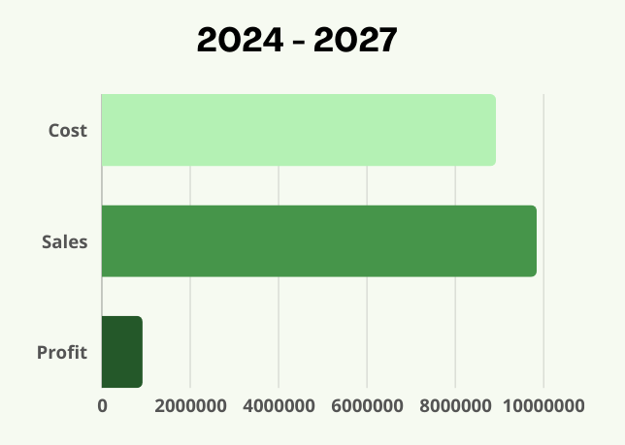
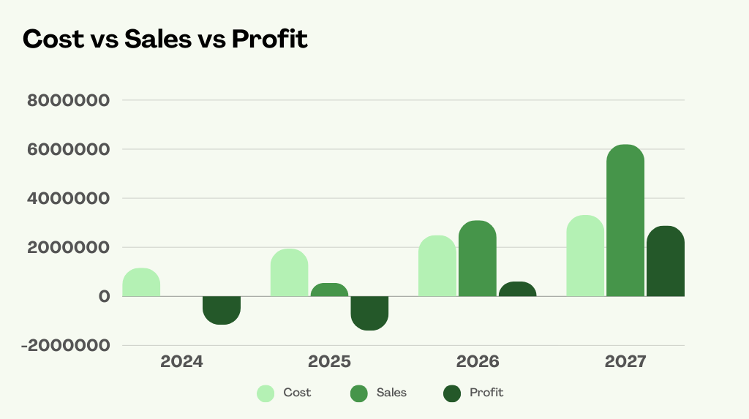
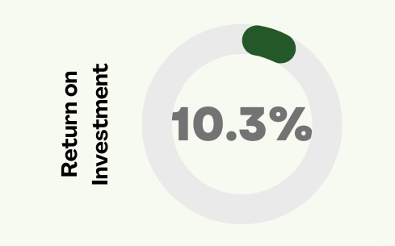
Overall Summary
8.9M
9.8M
6.1M
Return on Investment
3.1M
3.3M
921K
2.4M
2.8M
1.9M
1.1M
500K
600K
-1.1M
-1.3M

Slide 16
Thank You

Slide 17
Target Audience
By Job Role
Business Intelligence Professionals
Database Administrators (DBAs)
Product Managers
Business Users and Leadership Executives
Software Developers
By Industry
CPG & Manufacturing firms
SaaS providers
Educational institutes
Government institutes
Healthcare institutes
By Company size
Start-up firms
Small to Medium-sized Businesses (SMBs)
Units of large Enterprise Organizations
By Challenges & Pain Points
Firms who are highly dependent on data but cannot afford talent.
Teams struggling to improve productivity.
Missing skills for complex querying techniques.

Slide 18



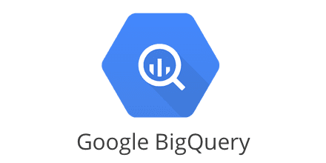


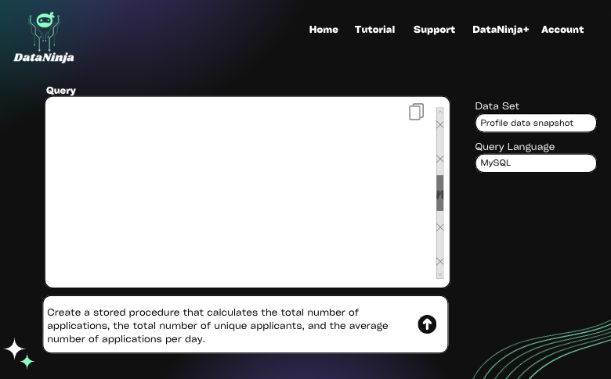


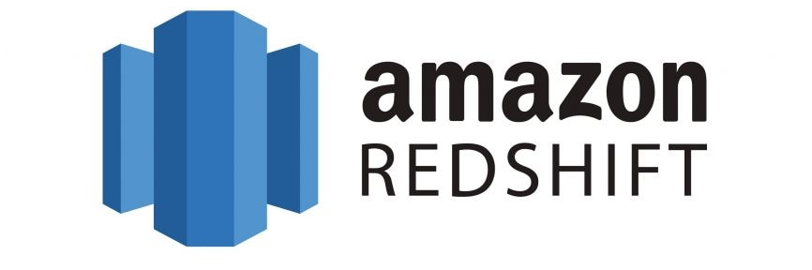

DataNinja Processing Layer
Execution Session
Self-service portal/DataNinja implementation
Users
Technical Architecture
Partition it into multiple volumes
Databases | Streams | Object Storage | Files | Documentation
Client
Native LLM
Questions in Natural Language
Users
Selects Datasets & query language
Session Setup
Login
Connection Setup
Responds with the appropriate results
And several other prebuilt connectors

Slide 19
Year 1 MVP Cost
Category | Billables | Source | Monthly | Yearly (Year 1)
LLM training | Compute cost | AWS ml.p4de.24xlarge | $23,000.00 | $3,00,000.00
Storage | Storage costs | Amazon EBS volumes 100TB volume Total Storage * Cost per GB-month = 102,400 GB * $0.10/GB-month | $10,240.00 | $1,22,880.00
FF&E | Laptops | Dell Xperion 32GB RAM 1699/laptop Approx 20 laptop |  | $33,980.00
 | Office space with utilities | Craigslist | $800.00 | $9,600.00
 | Internet | AT&T business internet upto 2 Gbps | $185.00 | $2,220.00
Ads/marketing | Ads campaign | LinkedIn | $700.00 | $8,400.00
 |  | Google | $500.00 | $6,000.00
Product Infrastructure | Ticketing system | Freshdesk | $60.00 | $720.00
 | CRM | Zoho CRM | $200.00 | $2,400.00
 | Software Licenses | Software Licenses | $300.00 | $3,600.00
Staffing | AI/NLP *2 | LinkedIn, Glassdoor, AMA, Upwork, Freelancer, Internal Network | $24,000.00 | $2,88,000.00
 | Full stack developers * 2 |  | $13,333.33 | $1,59,999.96
 | Data Engineer |  | $7,000.00 | $84,000.00
 | QA Engineer |  | $5,000.00 | $60,000.00
 | Sales/Marketing specialist |  | $4,166.67 | $50,000.00
 | Ad hoc Consultant |  | $1,500.00 | $18,000.00
Miscellaneous Expenses | Contingent Fund | Internal Budget Allocation | $1,250.00 | $15,000.00
Total |  |  | $92,235.00 | $11,64,799.96
Cost Incurred (MVP)

Slide 20
Billables | Year 2 |  | Year 3 |  | Year 4
 | Year 2 Details | Year 2 cost | Year 3 Details | Year 3 cost | Year 4 Details | Year 4 cost
Compute cost | AWS ml.p4de.24xlarge | $3,00,000.00 | AWS ml.p4de.24xlarge 2 instances | $6,00,000.00 | AWS ml.p4de.24xlarge 2 instances | $6,00,000.00
Storage costs | 200 TB volume | $2,45,760.00 | 300 TB volume | $3,68,640.00 | 500 TB volume | $6,14,400.00
Laptops | Dell Xperion 32GB RAM 1699/laptop Approx 30 laptop | $50,970.00 | Dell Xperion 32GB RAM 1699/laptop Approx 35 laptop | $59,465.00 | Same Dell, Plus additional other laptops | $70,000.00
Office space with utilities | 10% increase | $10,560.00 | 10% increase | $11,616.00 | Larger space | $19,200.00
Internet |  | $2,220.00 | 10% increase | $2,442.00 | 10% increase | $2,686.20
Ads campaign | 25% increase | $10,500.00 | 5% increase | $11,025.00 | 10% increase | $12,127.50
 | 25% increase | $7,500.00 | 5% increase | $7,875.00 | 10% increase | $8,662.50
Ticketing system | 3X increase | $2,160.00 | Same | $2,160.00 | 30% increase | $2,808.00
CRM | 2X increase | $4,800.00 | Same | $4,800.00 | 50% increase | $7,200.00
Software Licenses |  | $3,600.00 | Same | $3,600.00 | 25% increase | $4,500.00
AI/NLP *2 | 4 AI/NLP | $5,76,000.00 | 4 AI/NLP | $5,76,000.00 | 4 AI/NLP | $5,76,000.00
Full stack developers * 2 | Full stack developers * 2 | $1,59,999.96 | Full stack developers * 2 | $1,59,999.96 | Full stack developers * 4 | $3,19,999.92
Data Engineer | 3 Data Engineers | $2,52,000.00 | 3 Data Engineers | $2,52,000.00 | 5 Data Engineers | $4,20,000.00
QA Engineer | 2 QA | $1,20,000.00 | 2 QA | $1,20,000.00 | 4 QA | $2,40,000.00
Sales/Marketing specialist | 3 Sales | $1,50,000.00 | 3 Sales | $1,50,000.00 | 5 Sales | $2,50,000.00
Ad hoc Consultant | Same | $18,000.00 | Same | $18,000.00 | Same | $18,000.00
Contingent Fund | 100% increase | $30,000.00 | Approximate | $1,50,000.00 | Approximate | $1,50,000.00
 | approx 67% cost increase | $19,44,069.96 | approx 25% cost increase | $24,97,622.96 | approx 30% cost increase | $33,15,584.12
Cost Incurred 2025 - 2027

Slide 21
Competitor Pricing
ThoughtSpot params/tiers | Team | Essentials | Pro | Enterprise
users | 5 | 20 | custom | custom
rows | 5M | 25M | 500M | unlimited
support | in-app | in-app | pro level | enterprise level
organization | 1 | 1 | 1 | 400
security | None | row-level | pro level | enterprise level
Insights | None | Automated | Automated | Automated
Permission groups | 1 | 5 | 25 | unlimited
Freemium | yes | yes | yes | talk to sales
Price | $95/mos | $1250/mos | custom | custom
Kinetica | Kinetica Cloud |  | Enterprise
params/tiers | Free | Dedicates workloads (Coming soon) | AWS Managed service | Specialized needs
data | 10GB | unlimited | unlimited | custom, MFA, multi datacenter resilience
compute | shared | dedicated | suspend & resume as needed
dashboarding | No | with reveal | yes
support | basic | basic | basic | premium
 |  |  | No infra cost
price | $0.00 | $1.80/hr | $1.50/hr | custom

Slide 22
Product Strategy
Technology Advancements
Vision
Design
Querying databases is as simple as asking a question
Ready Stories
Intuitive and user-friendly interface
Focus on simplicity & accessibility
Gamification of user journey
Staying at the forefront of innovation:
Advancements in AI
Deliver maximum value
New feature roll-outs
Unlocking adjacent markets
Create a list of ready user stories that cover at least the first sprint.
Constraints
Growth & Marketing
Data Driven
Technology
Compatibility
Performance
Resource Limitations
Compliance
Data Privacy
Security
Market
Competition from querying tools
User preferences & Adoption barriers
Financial
Budget
Revenue
Tailored user acquisition strategies for user segments
Implement referral programs
Seamless user onboarding experience
Providing regular product updates, personalized recommendations
Utilize analytics and user insights to inform product decisions
Prioritize feature development
User behavior analysis
Identify areas for improvement
Personas
User feedback
Personas as a priority:
Product Managers
Leadership
BI Executives
Sales Executives
Other Data Users
Understand how they use the product & its features.
Continuous feedback loop
Customize design needs for large enterprise customers

Slide 23
Pricing & Revenue
Strategic Plans
Tailoring a tier-based pricing strategies.
To begin revenue realization implementing a steady revenue model.
01
Reach new user segments
02
Expand marketing efforts to reach new user segments and increase product adoption in the expanding markets.
Continued…
R&D
03
Stay updated, Invest in R&D to explore new features and functionalities that can further differentiate DataNinja in the market.
04
Partnerships
Forge partnerships with database vendors, technology providers
Notes:
While focusing on the features of the product and continuous development based on user feedback,
We have come up with these strategic plans – like pricing and revenue would be tier-based pricing strategies and have stable revenue based on that
Reach out to new user segments other than existing industries and increase product adoption
Invest more on R&D – allocate special budget for research to explore more functionalities which can differentiate Data Ninja in the market
Forging partnerships with database providers and technology providers

Slide 24
After Market
Customer Success & Support
Ensure value realization for customers
Community Engagement & Feedback loop
Ensure Customer satisfaction & staying competitive
Upgrades & Upselling
On top of Tech & feature bundling
Workshops & Documentation
Improve user adoption & stickiness

